Slide 1
Examlet 2 Review
CDA3101
15 September 2022

Slide 2
Examlet 2 Review
Sum of products / product of sums
Specialty circuits
Multiplexor, Decoder, Majority, Comparator
Translate from ARM machine code to assembly and vice versa

Slide 3
Digital Logic
A | B | C | Z
0 | 0 | 0 | 1
0 | 1 | 0 | 0
1 | 0 | 0 | 0
1 | 1 | 0 | 1
0 | 0 | 1 | 0
0 | 1 | 1 | 1
1 | 0 | 1 | 1
1 | 1 | 1 | 0
Express the truth table as the sum of products:

Slide 4
Digital Logic
A | B | C | Z
0 | 0 | 0 | 1
0 | 1 | 0 | 0
1 | 0 | 0 | 0
1 | 1 | 0 | 1
0 | 0 | 1 | 0
0 | 1 | 1 | 1
1 | 0 | 1 | 1
1 | 1 | 1 | 0
Express the truth table as the sum of products:

Slide 5
Digital Logic
A | B | C | Z
0 | 0 | 0 | 1
0 | 1 | 0 | 0
1 | 0 | 0 | 0
1 | 1 | 0 | 1
0 | 0 | 1 | 0
0 | 1 | 1 | 1
1 | 0 | 1 | 1
1 | 1 | 1 | 0
A’*B’*C’
A*B*C’
A’*B*C
A*B’*C
Express the truth table as the sum of products:

Slide 6
Digital Logic
A | B | C | Z
0 | 0 | 0 | 1
0 | 1 | 0 | 0
1 | 0 | 0 | 0
1 | 1 | 0 | 1
0 | 0 | 1 | 0
0 | 1 | 1 | 1
1 | 0 | 1 | 1
1 | 1 | 1 | 0
A’*B’*C’
A*B*C’
A’*B*C
A*B’*C
Express the truth table as the sum of products:
Z = A’*B’*C’ + A*B*C’ + A’*B*C + A*B’*C

Slide 7
Digital Logic
A | B | C | Z
0 | 0 | 0 | 1
0 | 1 | 0 | 0
1 | 0 | 0 | 0
1 | 1 | 0 | 1
0 | 0 | 1 | 0
0 | 1 | 1 | 1
1 | 0 | 1 | 1
1 | 1 | 1 | 0
Express the truth table as the product of sums:

Slide 8
Digital Logic
A | B | C | Z
0 | 0 | 0 | 1
0 | 1 | 0 | 0
1 | 0 | 0 | 0
1 | 1 | 0 | 1
0 | 0 | 1 | 0
0 | 1 | 1 | 1
1 | 0 | 1 | 1
1 | 1 | 1 | 0
Express the truth table as the product of sums:

Slide 9
Digital Logic
A | B | C | Z
0 | 0 | 0 | 1
0 | 1 | 0 | 0
1 | 0 | 0 | 0
1 | 1 | 0 | 1
0 | 0 | 1 | 0
0 | 1 | 1 | 1
1 | 0 | 1 | 1
1 | 1 | 1 | 0
A+B’+C
A’+B+C
A+B+C’
A’+B’+C’
Express the truth table as the product of sums:

Slide 10
Digital Logic
A | B | C | Z
0 | 0 | 0 | 1
0 | 1 | 0 | 0
1 | 0 | 0 | 0
1 | 1 | 0 | 1
0 | 0 | 1 | 0
0 | 1 | 1 | 1
1 | 0 | 1 | 1
1 | 1 | 1 | 0
A+B’+C
A’+B+C
A+B+C’
A’+B’+C’
Express the truth table as the product of sums:
Z = (A+B’+C) * (A’+B+C) * (A+B+C’) * (A’+B’+C’)

Slide 11
Multiplexor
Multiplexor circuit
Selects one data channel (from many input channels)
CONTROL LINES
2
0
1
2
3
INPUT DATA LINES
OUTPUT LINES

Slide 12
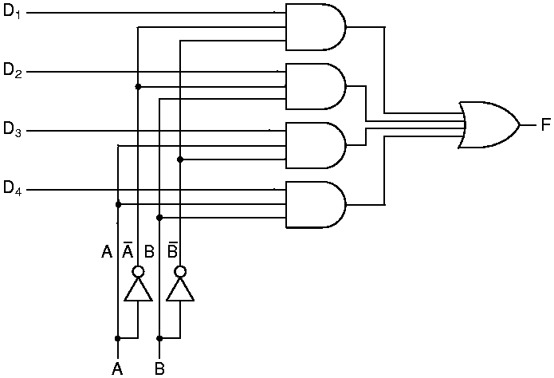
Multiplexor
Multiplexor circuit
Selects one data channel (from many input channels)
Maps the selected channel to the output channel
Sum-of-Products circuit
D₁ … D₄: Data channels
A, B: Control lines
F: Output channel
n control lines allows 2^{n} inputs
Example: To select D₁: A,B=0

Slide 13
If you need a multiplexor to choose which of 5 inputs, how many control lines do you need?

Slide 14
If you need a multiplexor to choose which of 5 inputs, how many control lines do you need?
The ceiling of log(5) = 3, so you would need 3 control lines

Slide 15
Decoder
Decoder circuit
Given n control lines
Select one of 2^{n} outputs to activate
CONTROL LINES
OUTPUTS - ONE IS ACTIVATED
3

Slide 16
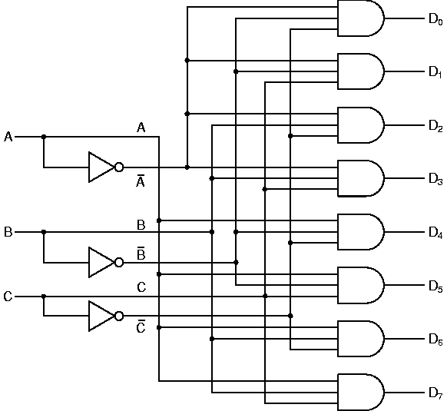
Decoder
Decoder circuit
Given n control lines
Select one of 2^{n} outputs to activate
Simple AND-gate circuit
D₁ … D₈ : Output channels
A, B, C : Control lines
Note: n control lines, 2^{n} outputs
Laws of Boolean Logic
Regulate circuit function
Identity Law 1 ∧ A = A, A∈{0,1}
Example: Select D₃: A, B, C = 0,1,1

Slide 17
If your decoder selects from among 40 outputs how many control lines does it need?

Slide 18
If your decoder selects from among 40 outputs how many control lines does it need?
The ceiling of log(40) = 6, so 6 control lines are needed
If you want to select the output channel 33, what should your control signals be?

Slide 19
If your decoder selects from among 40 outputs how many control lines does it need?
The ceiling of log(40) = 6, so 6 control lines are needed
If you want to select the output channel 33, what should your control signals be?
100001
Selecting a byte from memory is basically using a decoder.
32 bit memory addresses are used to select from 2³² addresses in memory

Slide 20
Comparator
Comparator circuit
Given two n-bit vectors A and B
Output 1 if A = B, or 0 otherwise
A
B

Slide 21
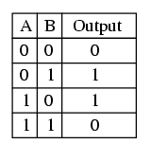

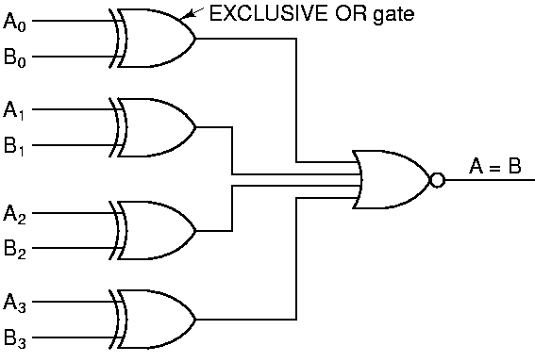
Comparator
Comparator circuit
Given two n-bit vectors A and B
Output 1 if A = B, or 0 otherwise
Simple XOR-gate circuit
A₀, A₁, …, A_{N-1} : Input vector #1
B₀, B₁, …, B_{N-1} : Input vector #2
Note: NOR gate combines N XOR gate outputs
If all inputs to this NOR gate are zero, output is 1
Laws of Boolean Logic
Example: Comparator for Bit i outputs 0 if A_{i} = B_{i}

Slide 22
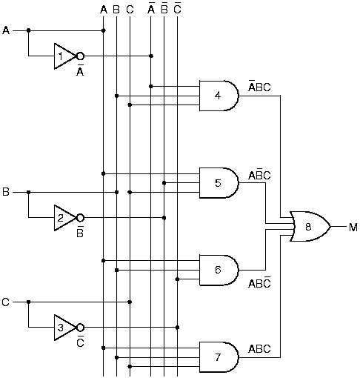
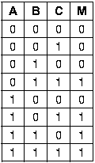
Majority vote circuit
Majority Function
Returns 1 if a majority of inputs are high (=1)
Formula: M(A,B,C) = A’BC + AB’C + ABC’ + ABC
Truth Table ⇒ SOP Circuit:
[Note: A = NOT(A)]
Application: In the Space Shuttle, 3 redundant circuits each compute the same function f. If a MAJORITY of circuit outputs agree (=1), then the 1-valued result is assumed to be correct.

Slide 23
ARM ISA: R-format instruction
STRUCTURE OF AN R-format INSTRUCTION
Instruction Fields:
Field Explanation:
opcode - basic operation of the instruction
rm – second source register
shamt – shift amount
rn – first source register
rd destination register
opcode rm shamt rn rd
11 bits 5 bits 6 bits 5 bits 5 bits

Slide 24
Sample problem
What is the 32 bit machine code corresponding to
LSL X10, X9, #3
(Look at reference sheet)
Opcode = 11010011011, Format = R

Slide 25
Sample problem
What is the 32 bit machine code corresponding to
LSL X10, X9, #3
(Look at reference sheet)
Opcode = 11010011011, Format = R, Rn is shifted and placed in Rd

Slide 26
Sample problem
What is the 32 bit machine code corresponding to
LSL X10, X9, #3
(Look at reference sheet)
Opcode = 11010011011, Format = R, RN shifted and placed in RD
11010011011 00000 000011 01001 01010
shamt = shift amount = 3
Rm is not used
Rn
Rd

Slide 27
Sample problem
What is the 32 bit machine code corresponding to
LSL X10, X9, #3
(Look at reference sheet)
Opcode = 11010011011, Format = R, RN shifted and placed in RD
11010011011 00000 000011 01001 01010
11010011011000000000110100101010
1101 0011 0110 0000 0000 1101 0010 1010
0xD3600D2A

Slide 28
ARM ISA: R-format instruction
ADD X9, X10, X11 → X9 = X10+X11
opcode rm shamt rn rd
11 bits 5 bits 6 bits 5 bits 5 bits
10001011000 01011 000000 01010 01001
SUB X9, X10, X11 → X9 = X10-X11
opcode rm shamt rn rd
11 bits 5 bits 6 bits 5 bits 5 bits
11001011000 01011 000000 01010 01001

Slide 29
ARM ISA: I-format instruction
Field Explanation:
opcode - basic operation of the instruction
Immediate – value of operand
rn – source register
rd destination register
opcode immediate rn rd
10 bits 12 bits 5 bits 5 bits

Slide 30
ARM ISA: I-Type Instructions
ADDI X9, X10, #100 → X9 = X10+100
opcode immediate rn rd
10 bits 12 bits 5 bits 5 bits
1001000100 000001100100 01010 01001

Slide 31
Sample Problem
What is the ARM assembly language instruction corresponding to
0x8A150293

Slide 32
Sample Problem
What is the ARM assembly language instruction corresponding to
0x8A150293
1000 1010 0001 0101 0000 0010 1001 0011

Slide 33
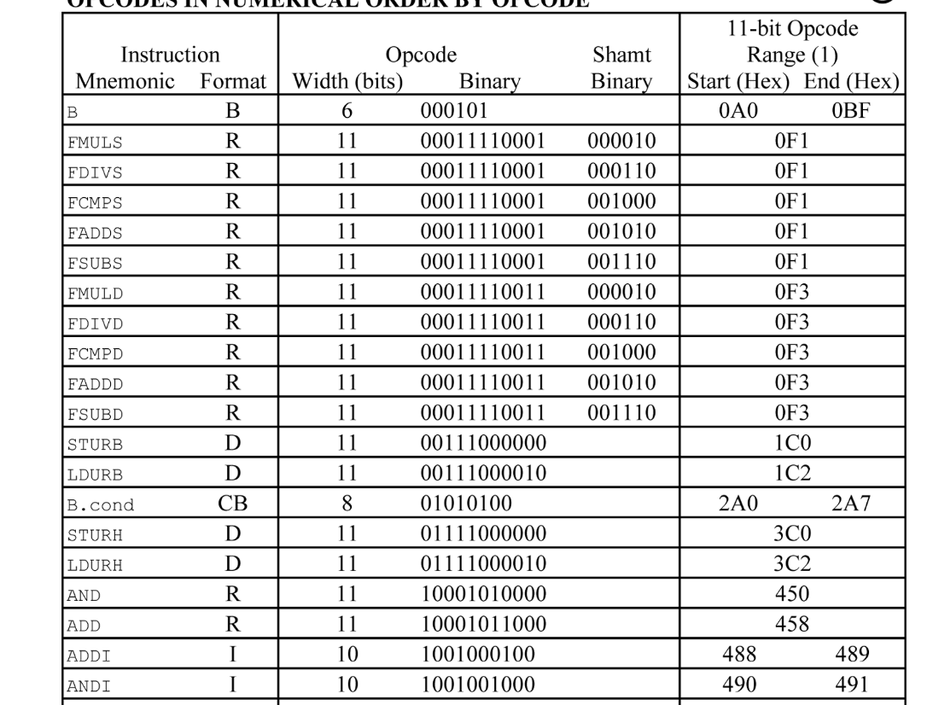
Sample Problem
What is the ARM assembly language instruction corresponding to
0x8A150293
10001010 0001 0101 0000 0010 1001 0011
The only opcode that starts with 10001010 is for AND
Therefore, this is an AND instruction, an R type

Slide 34
Sample Problem
What is the ARM assembly language instruction corresponding to
0x8A150293
10001010000 10101 000000 10100 10011
opcode rm shamt rn rd
rm = 10101 = X21
rn = 10100 = X20
rd = 10011 = X19
AND X19, X20, X21

Slide 35
Sample Problem
What is the ARM assembly language instruction corresponding to
0xD100C949

Slide 36
Sample Problem
What is the ARM assembly language instruction corresponding to
0xD100C949
1101 0001 0000 0000 1100 1001 0100 1001

Slide 37
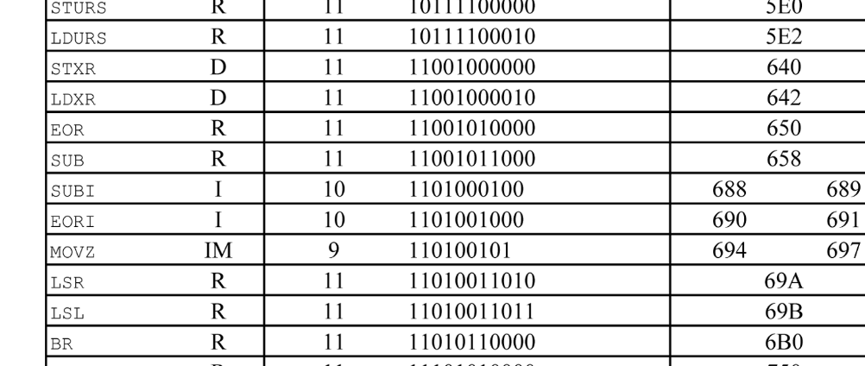
Sample Problem
What is the ARM assembly language instruction corresponding to
0xD100C949
11010001 0000 0000 1100 1001 0100 1001
The only opcode that starts with 11010001 is for SUBI
Therefore, this is a SUBI instruction, an I type

Slide 38
Sample Problem
What is the ARM assembly language instruction corresponding to
0xD100C949
1101000100 000000110010 01010 01001
opcode ALU imm. rn rd
ALU immediate = 000000110010 = 50
rn = 01010 = X10
rd = 01001 = X9
SUBI X9, X10, #50

